Slide 2
Dress Code Changes
A.
School uniforms
Everyone
Khaki pants or shorts
White shoes
Blue or White Polo Shirt
B.
Males:
Shirts tucked in
Females:
No flip flops
No Sandals
No Shorts
No Skirts or dresses
Shirts must also be tucked in
Applies to every Student male or female.
Any jackets or pullovers must be standard school colors

Slide 3
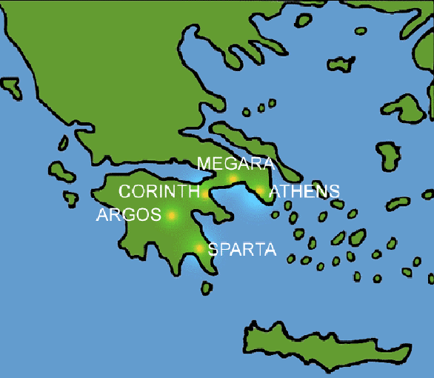
Ancient Greece: The Polis
The seeds of modern democracy

Slide 4
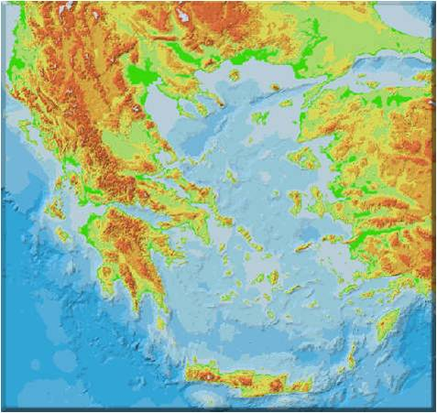
The Rise of the City States
City State-Greek communities that developed independently of each other
What was major factor in this development?
Geography- The rugged mountain terrain of Greece meant these cities developed differently

Slide 5
Polis
Polis- Greek name for a city state
Each was independent and self sufficient
Was the center of Greek identity
Greeks took great pride and loyalty in their polis
Athens and Sparta are two famous Greek city states
The idea of citizenship and the model of democracy can be traced to ancient Greece and the Polis
A citizen was not an individual. They belonged to the state.
The polis had no professional army or politicians, relying on its citizens instead.

Slide 6
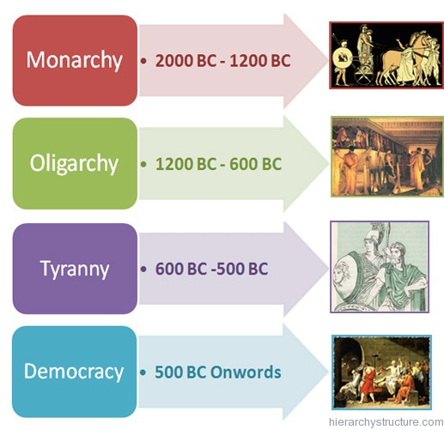
Governments of the Polis
Monarchy-government ruled by a king or queen
Oligarchy- government ruled by a few
Tyrant-Power was seized by force
Democracy- type of government where people vote.

Slide 7
Greek Citizenship Hierarchy
Free native born males
Women & Children (citizens but no rights)
Slaves & foreign born individuals (no political rights)
Is this truly a democracy?

Slide 8
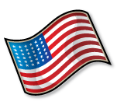
Different than the U.S.?
Some southern states did not let African Americans vote until the 1960s (Voting Rights Act 1965)
Women could not vote in the U.S. until 1920 (19th Amendment)
Eighteen year olds could not vote until the late 1970s.

Slide 9
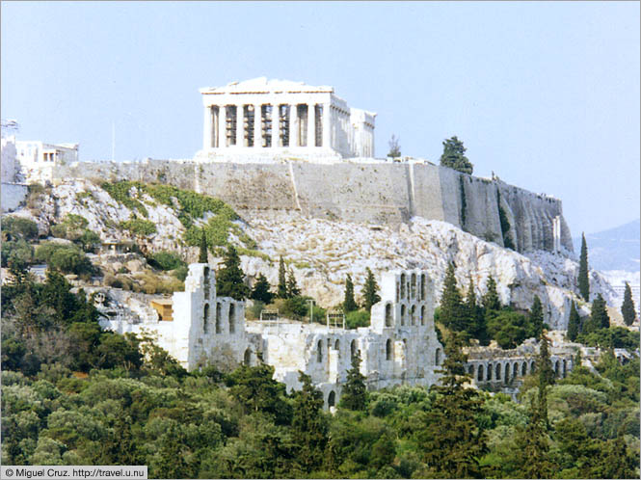
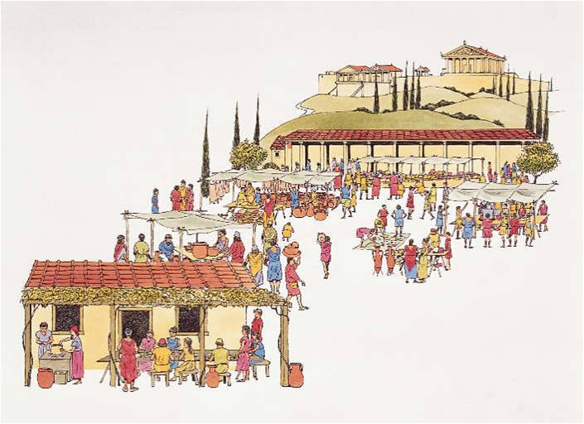
Polis
Acropolis = fortified hill (often with temples dedicated to the gods/goddesses)
Agora=Open area that was used as a meeting and marketplace for the people

Slide 10
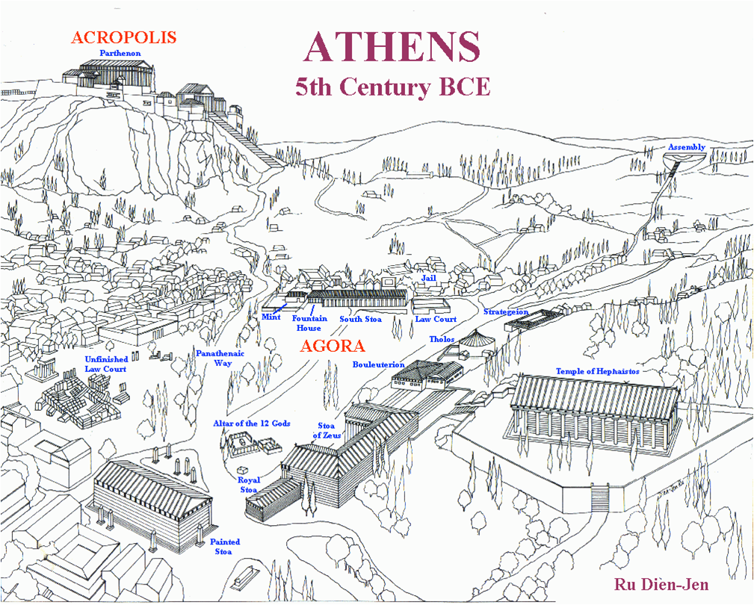

Slide 11
Origin of Modern English Words
Metropolis
Policy
Police
Politics
Indianapolis
Minneapolis
Annapolis

Slide 12
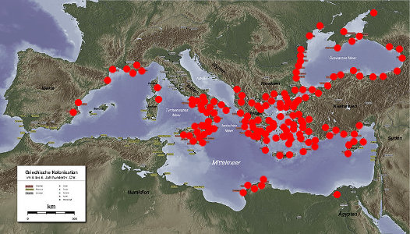
Spreading Greek Culture
As the population of the various polis increased, the need for more land and resources arose.
Greek City-States established colonies to ease overcrowding in mainland Greece.
These colonies would spread Greek culture throughout the Mediterranean region.

Slide 13
Videos
http://www.history.com/topics/ancient-greece/videos#the-peloponnesian-war
http://www.youtube.com/watch?v=xP-FsX0QW88

Slide 14
Review
What is Greece’s political contribution to the political world (especially the United States)?
Democracy
What was the Greek name for a city state?
Polis

