Slide 1
Chapter 27 Worms and Mollusks

Slide 2
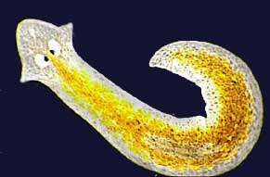
27-1 Flatworms

Slide 3
What is a Flatworm?
What are some of the defining features of flatworms?

Slide 4
What is a flatworm?
Flatworms are soft, flattened worms that have tissues and internal organ systems.
They are the simplest animals to have three embryonic germ layers, bilateral symmetry, and cephalization.

Slide 5
What is a Flatworm?
Flatworm are acoelmates, which means they have no coelom
A coelom is a fluid-filled body cavity that is lined with tissue derived from mesoderm
The digestive cavity is the only body cavity in a flatworm
Flatworms have bilateral symmetry.

Slide 6
What is a Flatworm
Three germ layers of a flatworm
Ectoderm
Mesoderm
Endoderm
Digestive cavity
Page 683 Figure 27-1

Slide 7
Form and Function in Flatworms
Form and Function in Flatworms
Flatworms are thin and most of their cells are close to the external environment.
All flatworms rely on diffusion for respiration, excretion, and circulation.

Slide 8
Form and Function in Flatworms
Free-living flatworms have organ systems for digestion, excretion, response and reproduction.
Parasitic species are typically simpler in structure than free-living flatworms.

Slide 9
Form and Function in Flatworms
Feeding
Flatworms have a digestive cavity with a single opening through which both food and wastes pass
Near the mouth is a muscular tube called a pharynx
Flatworms extend the pharynx out of the mouth. The pharynx then pumps food into the digestive cavity.

Slide 10
Form and Function in Flatworms
Most parasitic worms do not need a complex digestive system
They obtain nutrients from food that have already been digested by their host.

Slide 11
Form and Function in Flatworms
Respiration, Circulation, and Excretion
Flatworms do not need a circulatory system to transport materials.
Flatworms rely on diffusion to
transport oxygen and nutrients to their internal tissues, and
to remove carbon dioxide and other wastes from their bodies.

Slide 12
Form and Function in Flatworms
Flatworms have no gills or respiratory organs, heart, blood vessels, or blood
Some flatworms have flame cells which are specialized cells that remove excess water from the body
Flame cells may filter and remove metabolic wastes.

Slide 13
Form and Function in Flatworms
Response
In free-living flatworms, a head enclosed ganglia, or groups of nerve cells, that control the nervous system.
Two long nerve cords run from the ganglia along both sides of the body.

Slide 14
Form and Function in Flatworms
Many free-living flatworms have eyespots.
Eyespots are groups of cells that can detect changes in light
Most flatworms have specialized cells that detect external stimuli
The nervous system of free-living flatworms allow them to gather information from their environment.

Slide 15
Form and Function in Flatworms
Movement
Free-living flatworms move in two ways.
Cilia on their epidermal cells help them glide through the water and over the bottom of a stream or pond
Muscle cells controlled by the nervous system allow them to twist and turn.

Slide 16
Form and Function in Flatworms
Reproduction
Most free-living flatworms are hermaphrodites that reproduce sexually
A hermaphrodite is an individual that has both male and female reproductive organs
Two worms join in a pair and deliver sperm to each other
The eggs are laid in clusters and hatch within a few weeks.

Slide 17
Form and Function in Flatworms
Asexual reproduction takes place by fission, in which an organism splits in two
Each half grows new parts to become a complete organism
Parasitic flatworms often have complex life cycles that involve both sexual and asexual reproduction.

Slide 18
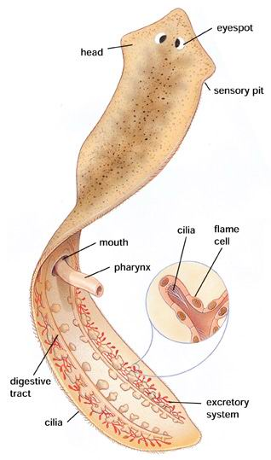

Slide 19
Groups of Flatworms
What are the characteristics of the three groups of flatworms?

Slide 20
Groups of Flatworms
Groups of Flatworms
Turbellarians
Flukes
Tapeworms
Most turbellarians are free-living
Moth other flatworms species are parasites.

Slide 21
Groups of Flatworms
Turbellarians are free-living flatworms. Most live in marine of fresh water
Most species live in the sand or mud under stones and shells

Slide 22
Groups of Flatworms
Flukes
Flukes are parasitic flatworms. Most flukes infect the internal organs of their host.

Slide 23
Form and Function in Flatworms
Flukes can infect the blood or organs of the host.
Some flukes are external parasites.
In the typical life cycle of parasitic flukes, the fluke lives in multiple host.

Slide 24
Form and Function in Flatworms
Life cycle of a Blood Fluke
A blood fluke’s primary host is a human
Blood flukes infect humans by burrowing through the skin.
Once inside the human, they are carried to the blood vessels of the intestines.
In the intestines the flukes mature and reproduce.
Embryos are released and are passed out of the body with feces.

Slide 25
Form and Function in Flatworms
If the embryos reach water, they develop into swimming larva that infect a snail ( the intermediate host)
An intermediate host is an organism in which a parasite reproduces asexually.
Larvae that result from asexual reproduction are released from the snail into the water to begin the life cycle again.

Slide 26
Form and Function in Flatworms
Tapeworms
Tapeworms are long, flat parasitic worms that are adapted to life inside the intestines of their host.

Slide 27
Form and Function in Flatworms
Tapeworm have no digestive tract and absorb digested food directly through their body walls
The head of an adult tapeworm, called a scolex, is a structure that can contain suckers or hooks.
The tapeworm uses its scolex to attach to the intestinal wall of it host.
Page 688 figure 27-6

Slide 28
Form and Function in Flatworms
Proglottids are the segment that make up most of the worm’s body.
Mature proglottids contain both male and female reproductive organs
Sperm produced by the testes (male reproductive organs), can fertilize eggs of other tapeworms or of the same individual.

Slide 29
Form and Function in Flatworms
After the eggs are fertilized, the proglottids break off and burst to release the zygotes.
The zygotes are passed out of the host in feces
The eggs ingested be an intermediate host hatch and grow into larvae.
Larvae burrow into the intermediate host’s muscle tissue.

Slide 30
Form and Function in Flatworms
Larvae from a dormant protective stage called a cyst
If a human eats incompletely cooked meat containing these cysts, the larvae become active and grow into adult worms within the humans' intestines, beginning the cycle again.

