Slide 1
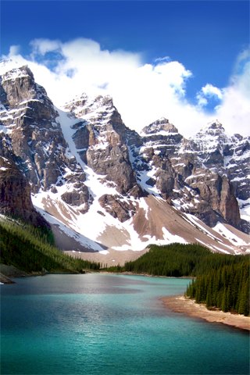
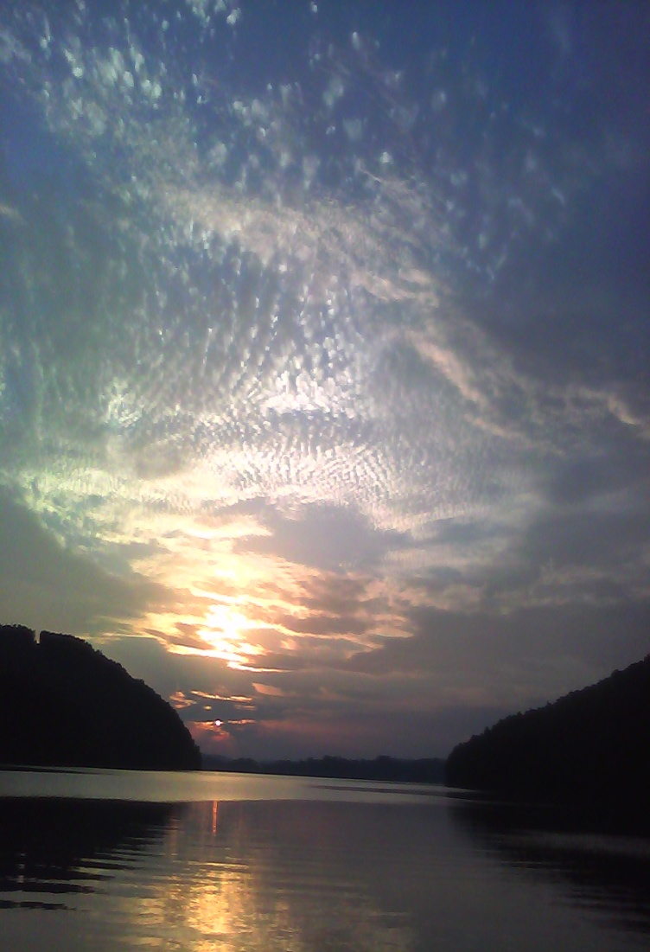
Aquatic Ecosystems

Slide 2
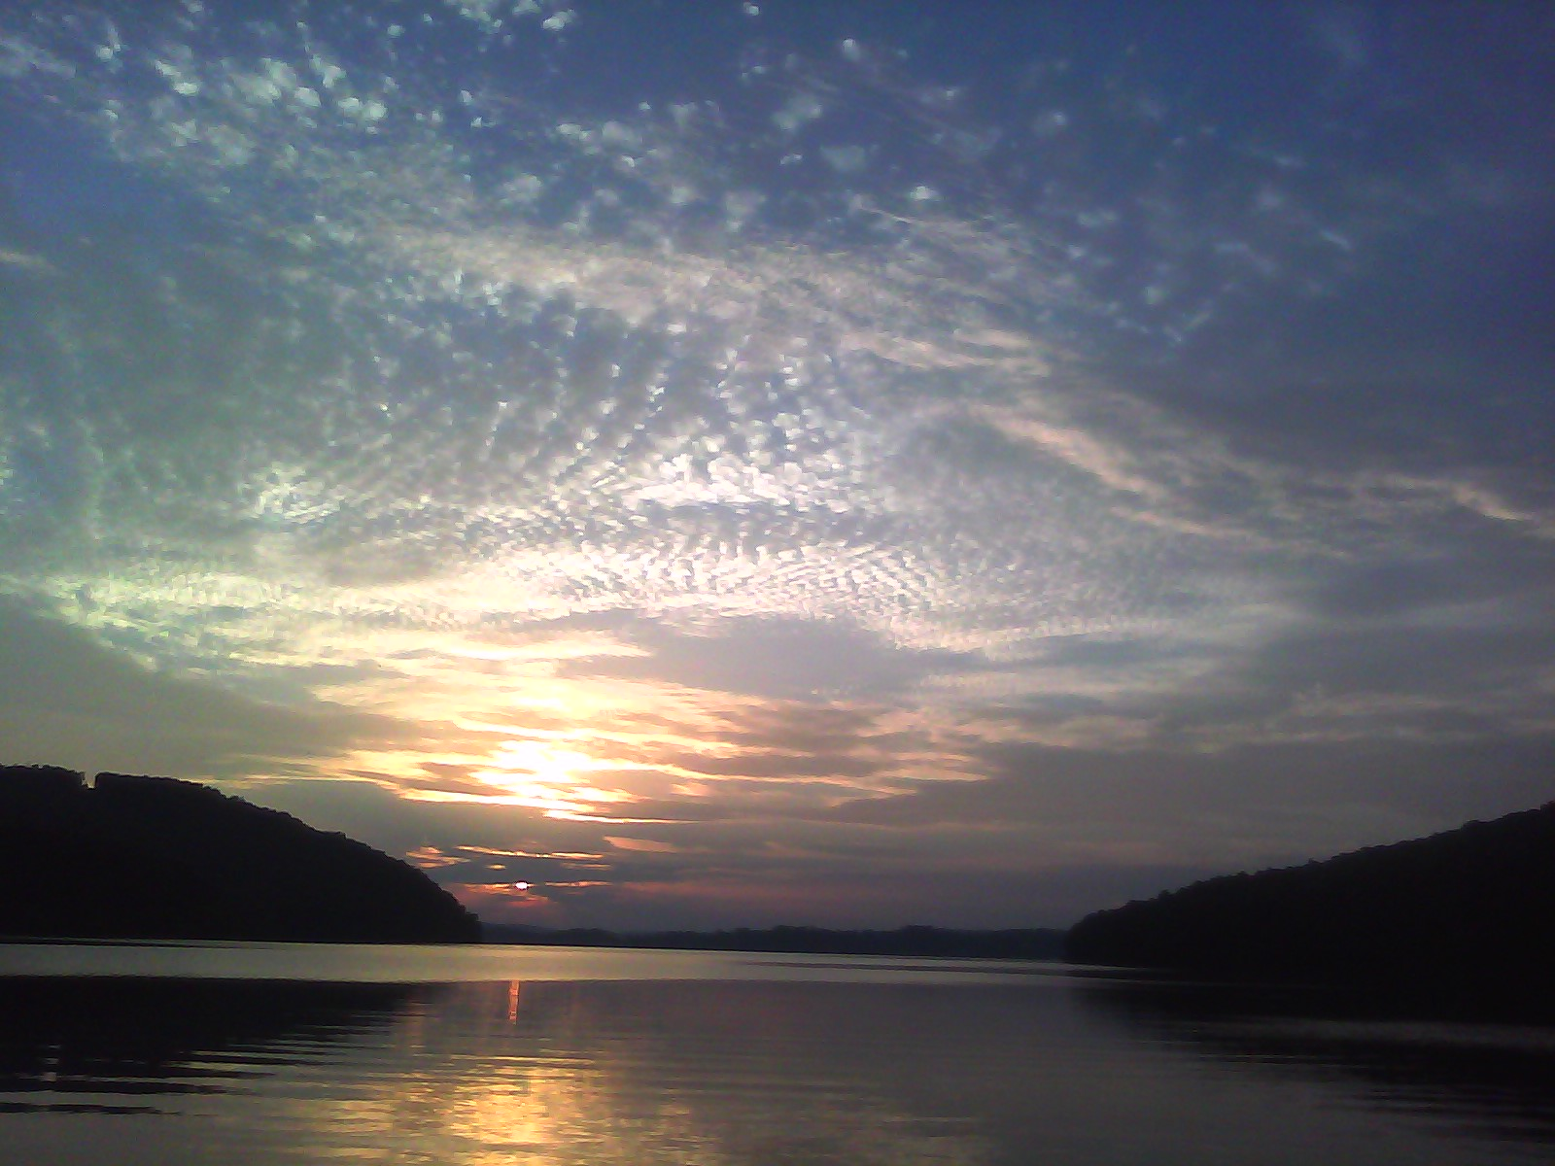
Freshwater Ecosystems
-Aquifers -Springs -Ponds
-Lakes -Creeks/Streams -Rivers
-Wetlands
Makes up < 3 % of water on earth

Slide 3
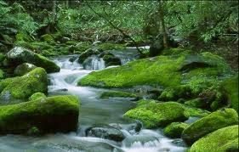
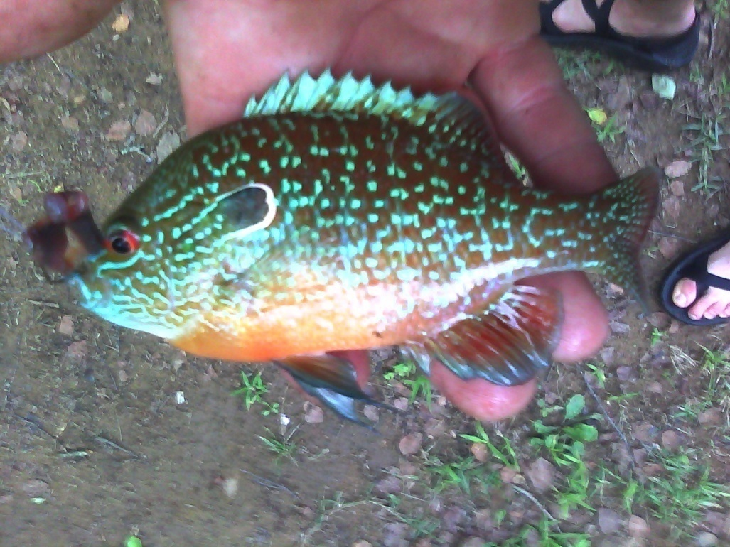
Essential for Freshwater Ecosystem
Dissolved Oxygen
Minerals and Nutrients
Species Diversity

Slide 4
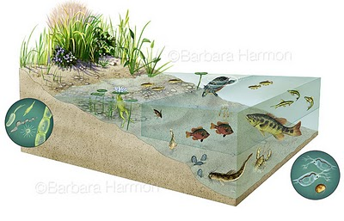
Ponds and Lakes
Zones:
Littoral
Photic
Benthic
Plankton:
Zooplankton
Phytoplankton
⃪
⃪
Decomposers

Slide 5
Eutrophication
An increase in aquatic plants or alga due to an increase in nutrients.

Slide 6
Large-Scale Eutrophication

Slide 7
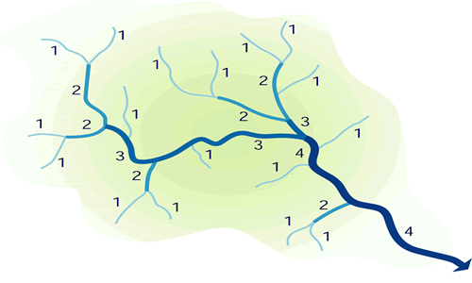
Streams, Creeks, and Rivers
Stream Order:

Slide 8
Alabama’s Natural Setting
1,438 miles of navigable channels
77,000 miles of rivers and streams
563,000 acres of lakes, ponds, reservoirs
33.5 trillion gallons of water flow through river systems.
16 major locks and dams on 6 river systems

Slide 10
Geographic regions of Alabama

Slide 11
Shoal Creek
What impact are these dams having on this creek system?
Accumulation of water and habitat division.

Slide 12
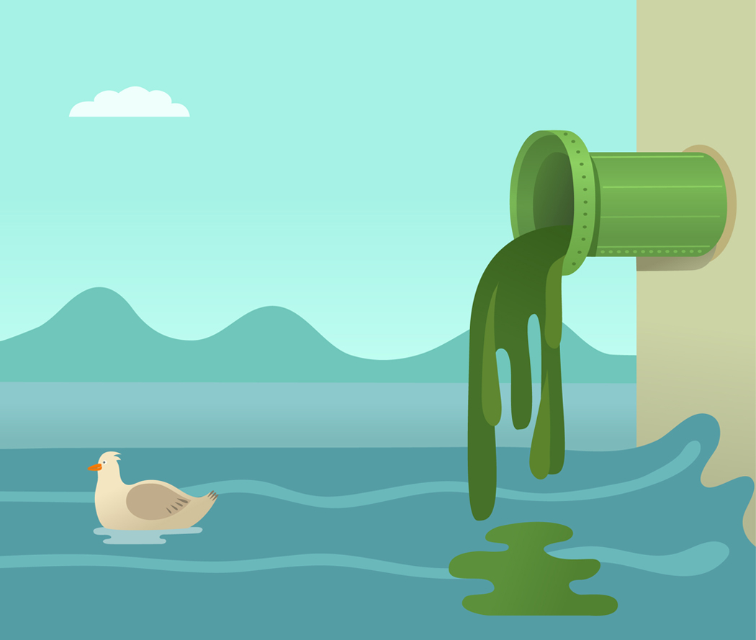
Human Influence
Extensive pollution:
-Industrial
-Agricultural
-pesticides
-animal waste
-Household waste
-septic tanks
-Oil spills
-Nuclear waste

Slide 13
Why should aquatic ecosystems be a major concern for future scientists?
Because the final consumers of water are. . .
Humans

