Slide 1
White Plains Water Park
With students around you, discuss the following questions:
(1)In what year and what city do you think the first water amusement park opened up in the U.S.?
(2) What factors make a successful water park?
(3) Could we open one in White Plains?

Slide 2
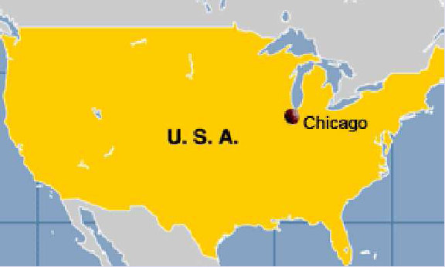
“Captain Boynton’s Water Chutes”
It opened in 1894 in the city of Chicago, Illinois. 12 years later the theme park had to close. Why do you suppose?

Slide 3
White Plains Water Park
Your group is in charge of deciding admission prices to the new water park.
Decide what your adult ticket price is(anyone 18 or older) and children’s ticket price(17 and under)
Also would you offer any discounts for a large group?
Be prepared to explain your ticket prices.

Slide 4
White Plains Water Park
We are going to use the following prices:
ADULT- $15 CHILDREN- $12
GROUP will be P = 100 + 10A + 8C, where
P = Price, A = Adult, and C = Children
Write this information down, you will need it to answer the questions on the next slide

Slide 5
Regular Price → Adult= $15, Child = $12
Group Price→ P = 100 + 10A + 8C
(1) How much does it cost for 50 Adults and 80 Children to be admitted into the Water Park at regular price?
(2) Is it better for a group of 7 adults and 20 children to pay the regular admission price or use the group admission prices? Explain.
(3) What is the AVERAGE price ticket for a GROUP of 30 adults and 40 children?
(4) If a school had only $1000 to spend, how many people could they pay for to be admitted using the (1) regular price (2) group price.
Answers
#1 $1710
#2 Regular = $345 and Group = $330 so by $15 group price
#3 About $10.29
#4 (1) probably 80 or less (2) probably around 100-110.

Slide 6
Admission + ? = Profit
Besides the admission price, what is something else that your group will probably want to charge for to help increase your profit? Take a couple of minutes and discuss.
I would definitely charge people to park and for sure I would have concessions.

Slide 7
Concessions
Lets use P = 4.50V – 1000
With your group members, discuss what the letters P and V stand for and what the 4.50 and -1000 stand for in this formula.
P = Profit and V = Visitors
4.50 = average amount to spent be each visitor on concessions
-1000 = what it cost the park to get the concessions prepared and ready for sale

Slide 8
Sample Example P = 4.50V - 1000
Use the formula to answer the following questions:
(1) Find the profit for the park if they have 1000 visitors, 1500 visitors, and 3000 visitors.
(2) What is happening to the profit margin as the number of visitors increase? Explain your answer.
(3) Is it possible for the concession part of the water park to lose money? Explain your answer.
(4) What is the minimum number of visitors needed for the water park to make money off concessions? Explain your answer.

Slide 9
Answers (P = 4.50V – 1000)
(1) Find the profit for the park if they have 1000 visitors, 1500 visitors, and 3000 visitors.
1000 = $3500, 1500 = $5750, 3000 = $12, 500
(2) What is happening to the profit margin as the number of visitors increase? Explain your answer.
Increasing by more than double
(3) Is it possible for the concession part of the water park to lose money? Explain your answer.
Yes, if there are not enough visitors, weather, etc.
(4) What is the minimum number of visitors needed for the water park to make money off concessions?
223 {4.50(223) – 1000} = $3.50 profit

